Slide 1
Citizen Involvement in the Legislative Process
Simple Action Steps
Copyright OK-SAFE, Inc.™
Website: ok-safe.com Contact: oksafe@windstream.net
Rev. 01/2013
Notes:
This presentation is broken up into 6 parts – The Basics; Lobbying; Leadership; Legislation; How to Read A Bill; Influencers

Slide 2
PART ONE
Introductory – The Basics
Notes:
This presentation is broken up into 3 parts – The Basics; Lobbying; and Website and Legislation

Slide 3
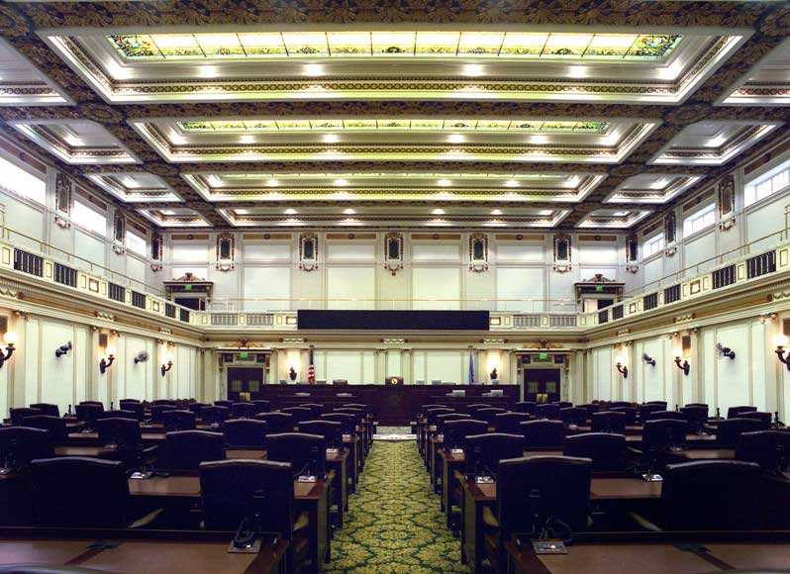
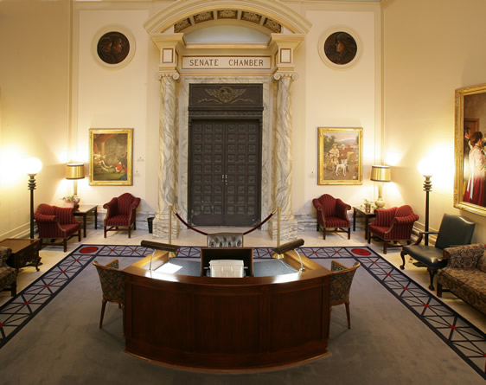
OK State Legislature house and Senate
OK Legislative Sessions ~ 16-weeks
  Begins first Monday of February – 2/4/2013
  Ends last day of May - 5/31/2013
  Between sessions is referred to as the Interim

Slide 4
Find Your Legislator
Oklahoma Legislature Website:
  www.oklegislature.gov
  Click “Find My Legislator”
Put your Representative’s and Senator’s name and contact information in your cell phone
Add both of them to your email list
Notes:
To find your district:
Click on:
oklegislature.gov
House or Senate Home Page
Information
House District Maps

Slide 5
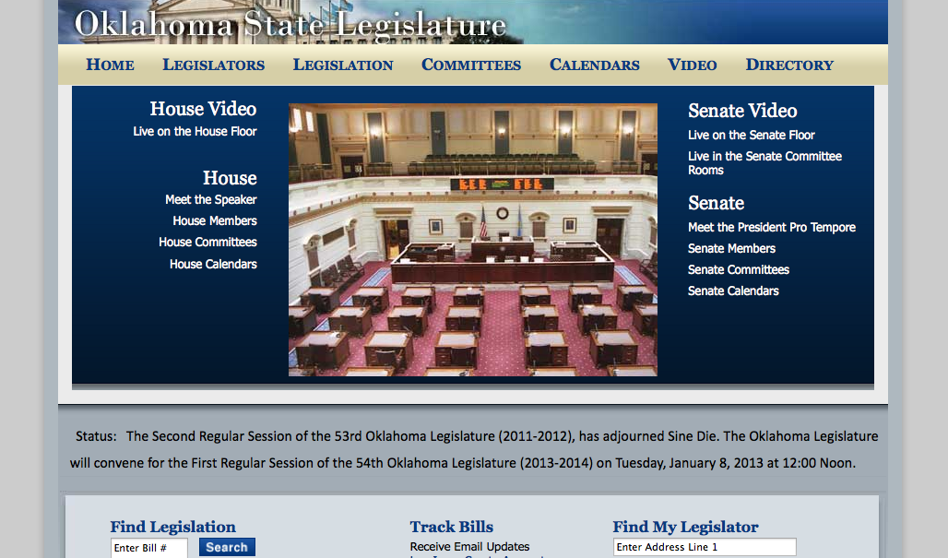
www.oklegislature.gov
Make this your home page
Review:
Home Pages
Legislators
Legislation
Committees
Video Options
Notes:
Discuss the various options -
How to find House and Senate Home Page
Find My Legislator including phone and email
List of Legislators
Find Legislation
Watch Video from anywhere
Track Bills
Find Committees

Slide 6

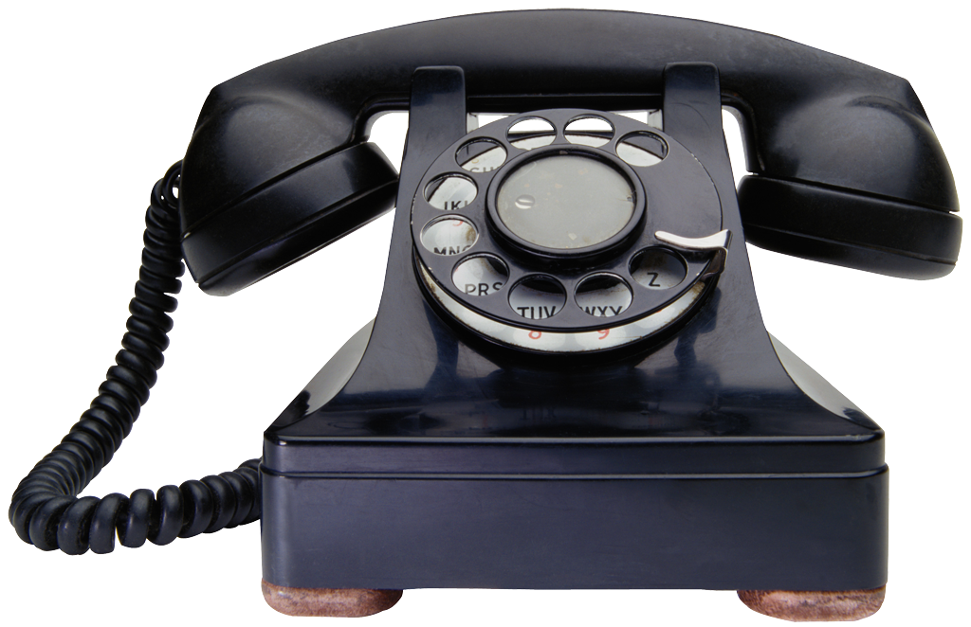
Call and Meet for Coffee

Slide 7

Review…
Identify your legislators
Add their contact information to your phone
Call and meet over coffee
Make home page: oklegislature.gov
Notes:
This presentation is broken up into 3 parts – The Basics; Lobbying; and Website and Legislation

Slide 8
PART TWO
The next step: Lobbying
Notes:
This presentation is broken up into 3 parts – The Basics; Lobbying; and Website and Legislation

Slide 9

Visit elected official’s Office
Both in the district and at the capitol
Be polite and calm
Explain your interests
Keep in touch via phone and email
Get to know the legislative assistant
Send a thank you
No insurance exchange!

Slide 10
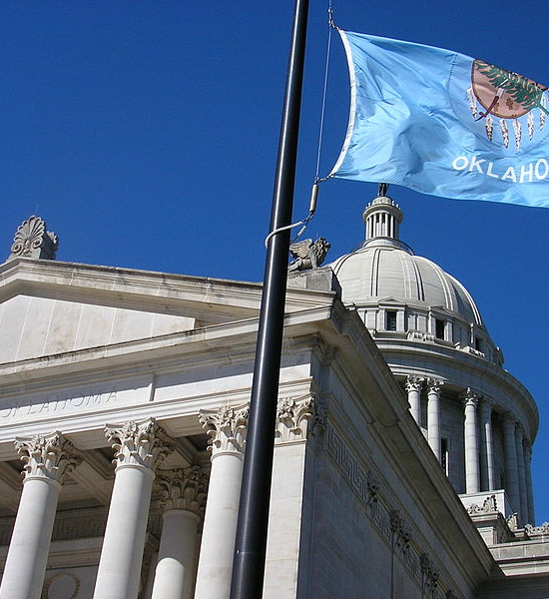
Lobbying – Be prompt, friendly
Make appointment or drop in
Go in groups of 2 or 3
Identify yourself/your organization
Briefly explain why you are there
Have bulleted handouts
Notes:
Show examples of bulleted handouts

Slide 11

Write to your Legislator
Good Grief - Be Brief!
Have a specific message:
“I object to the Health Insurance Exchanges.”
Include excerpt and page # from the actual bill
Use your own words
Sign your name, include home address and phone number
Write letters to the Editor!

Slide 12
Oklahoma Capitol Information add to your phone contact list
House: 1-405-521-2711
1-800-522-8502
Senate: 1-405-524-0126
1-800-865-6490
Capitol Address:
2300 N. Lincoln Blvd
State Capitol Building
Oklahoma City, OK 73105

Slide 13
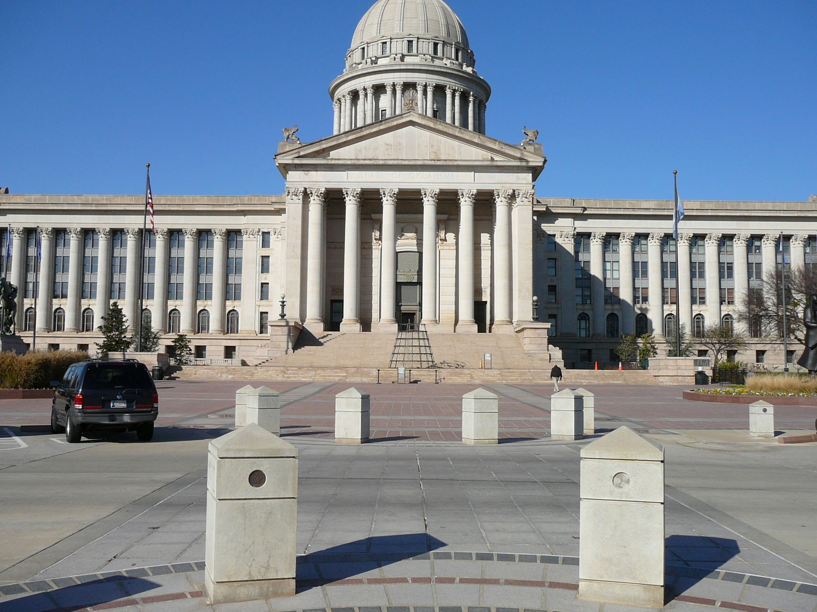

Slide 14
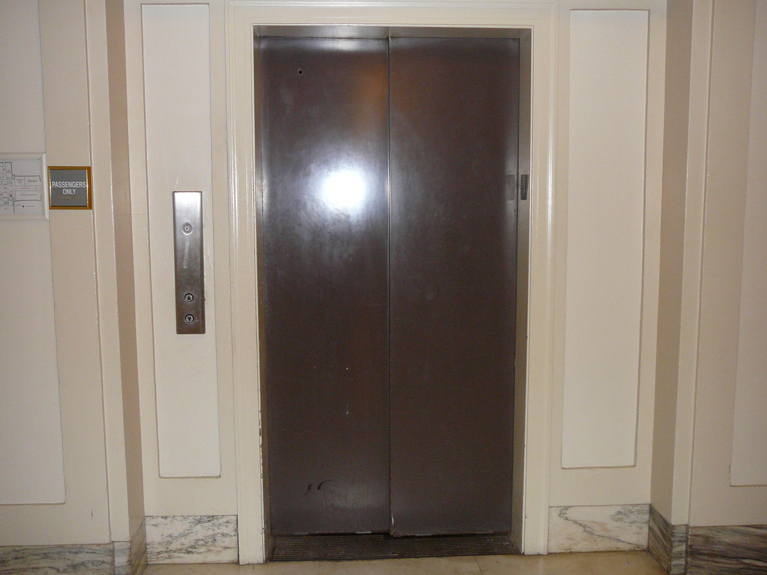
“4th Floor, Please!”

Slide 15
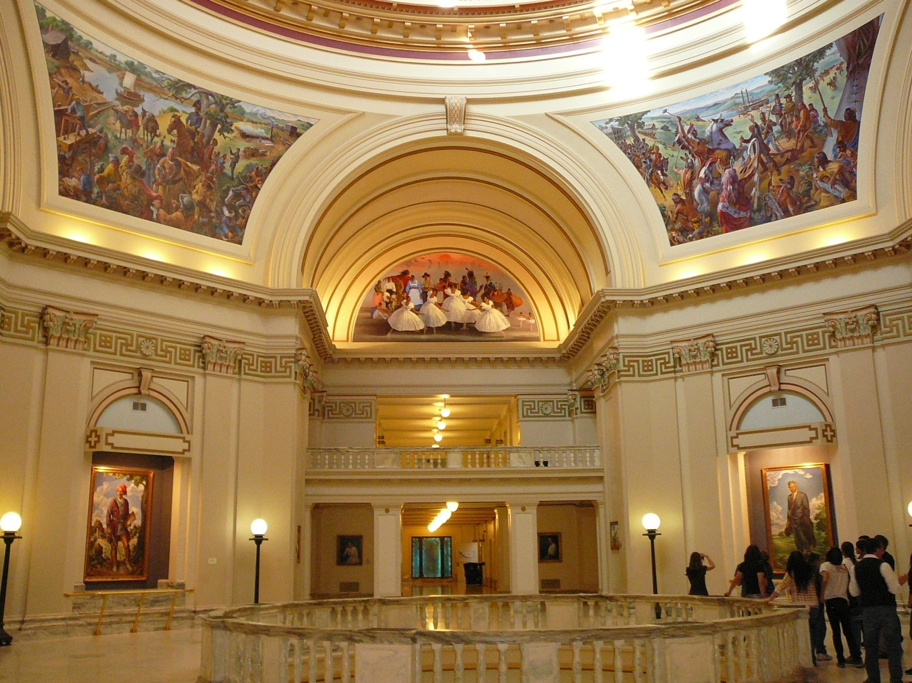
“Ooh!” “Ahh!”
Notes:
Look at all the artwork, admire the dome, and locate the restrooms. Get it all out of your system before session starts!

Slide 16
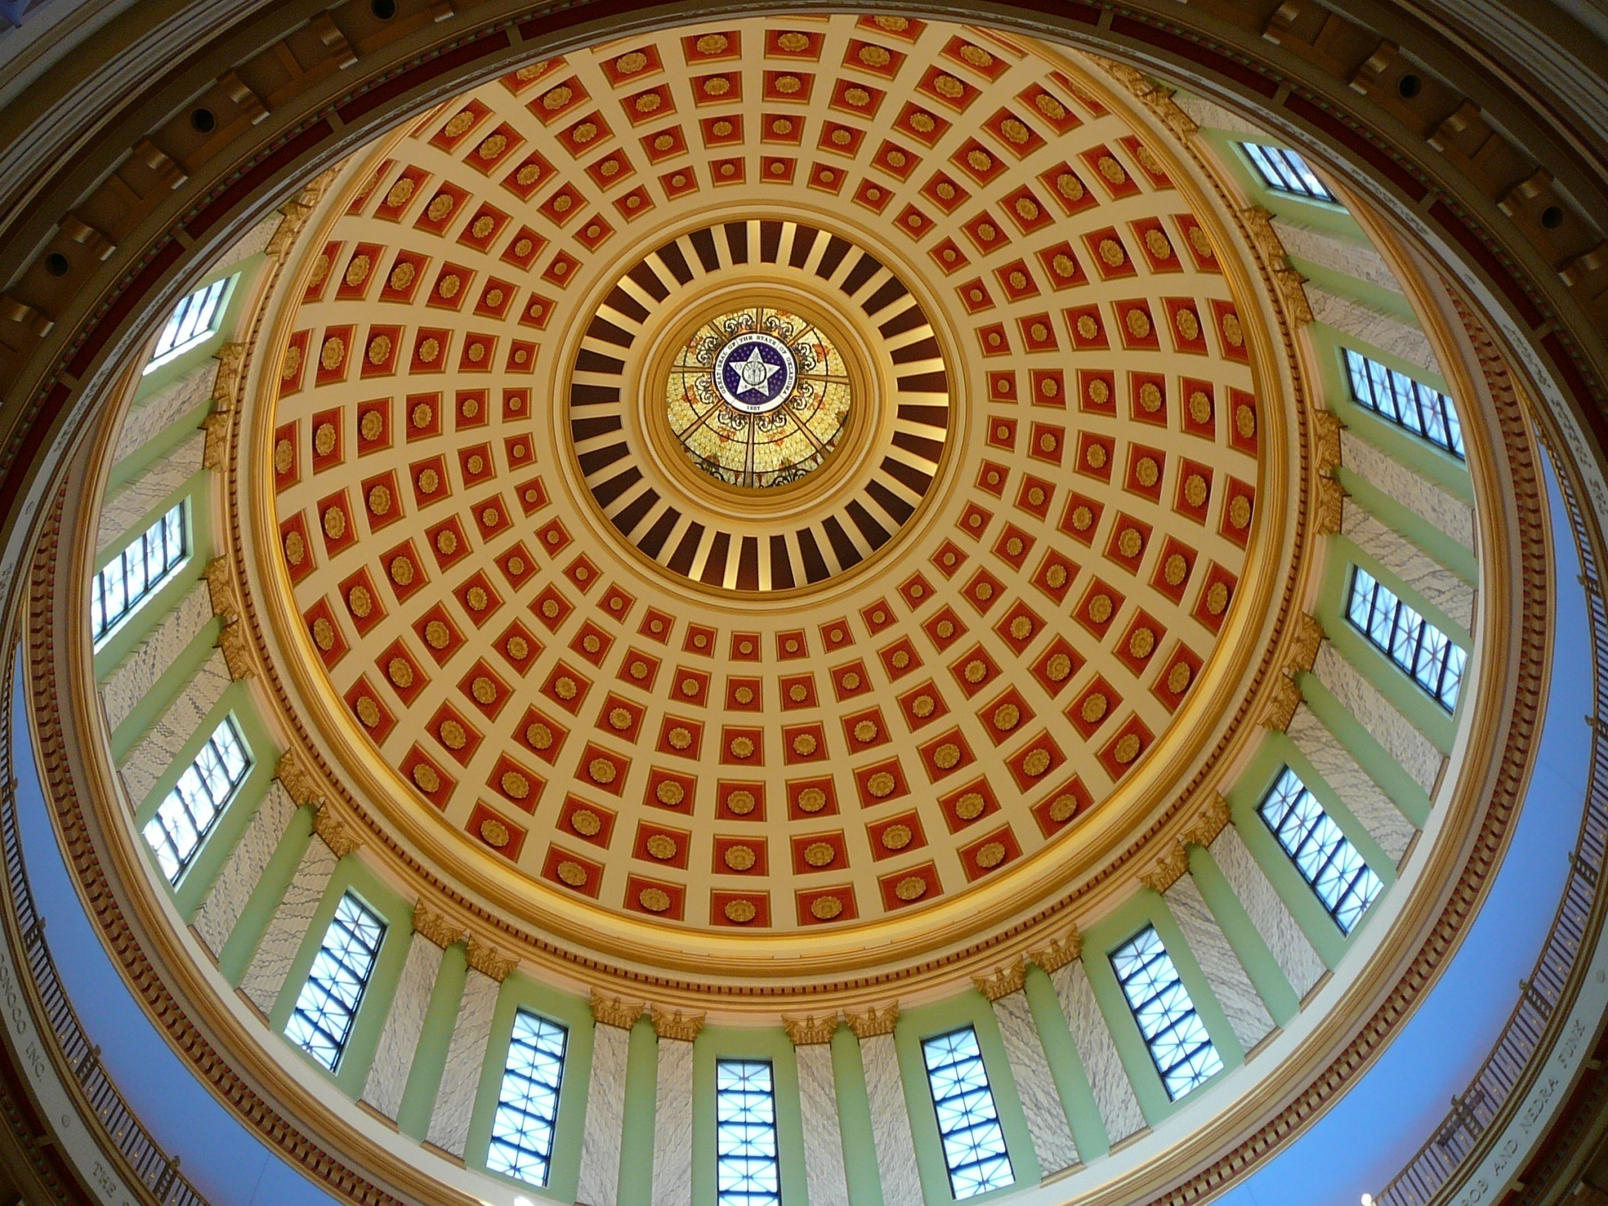
Notes:
Admire the dome!

Slide 17
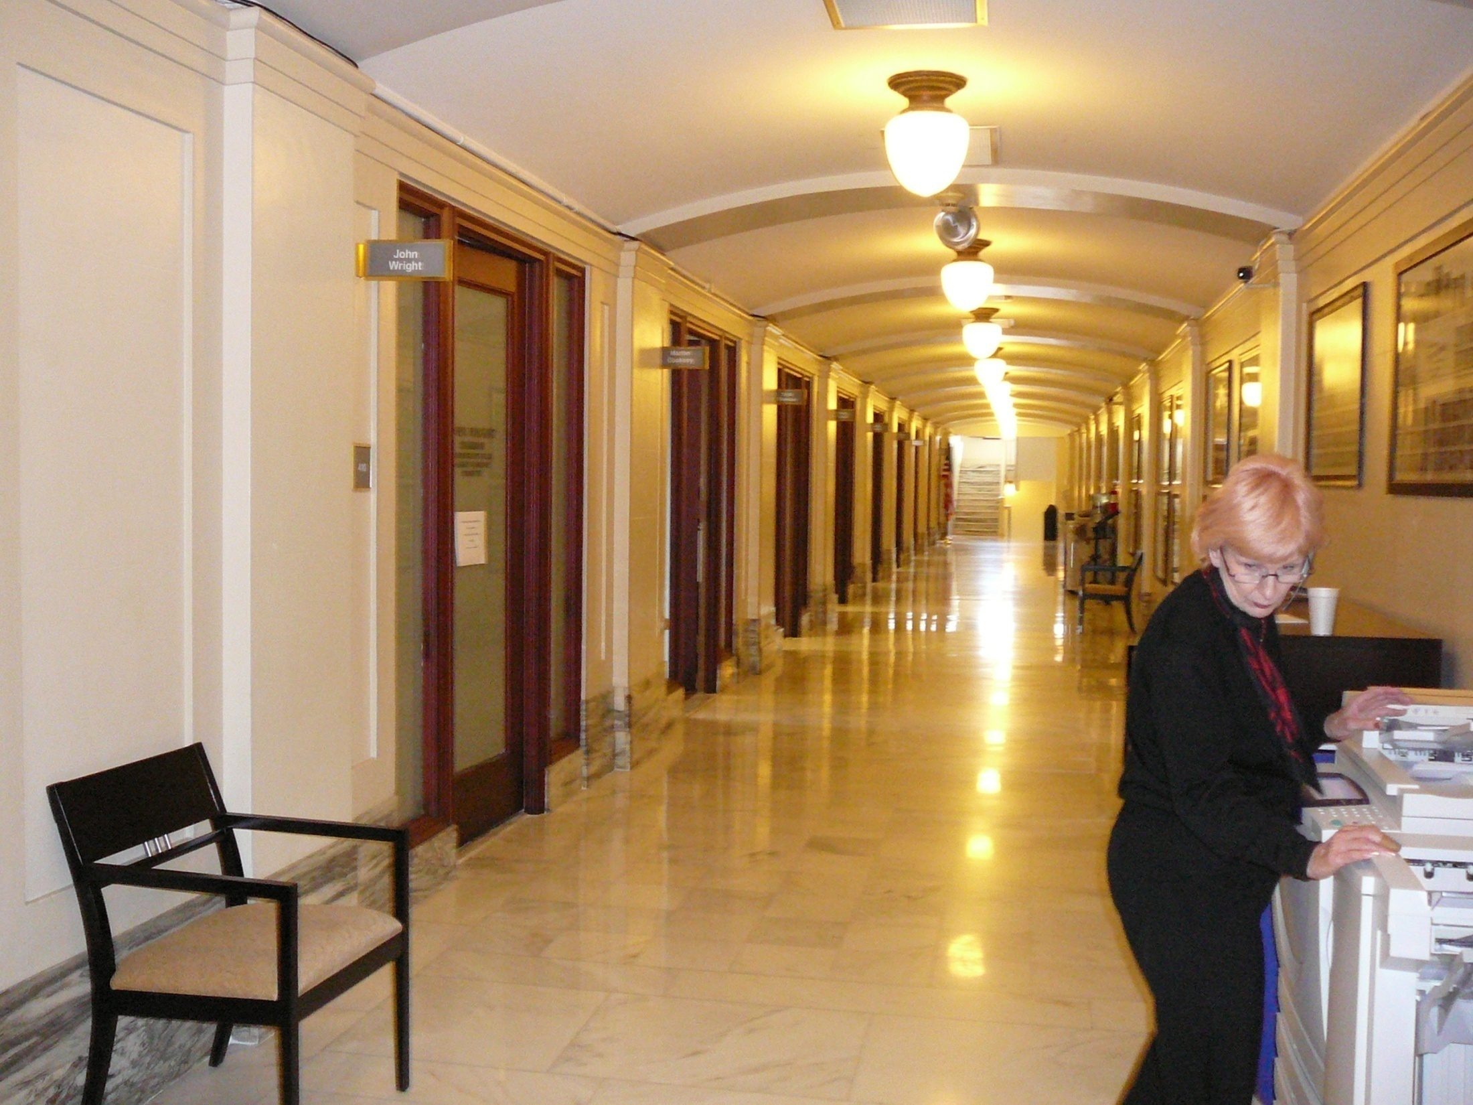
Nice lady
Notes:
Legislative Assistants are a great help and can help you schedule time with your legislator. BE POLITE TO THEM – THEY CAN OR THEY CAN HINDER…

Slide 18
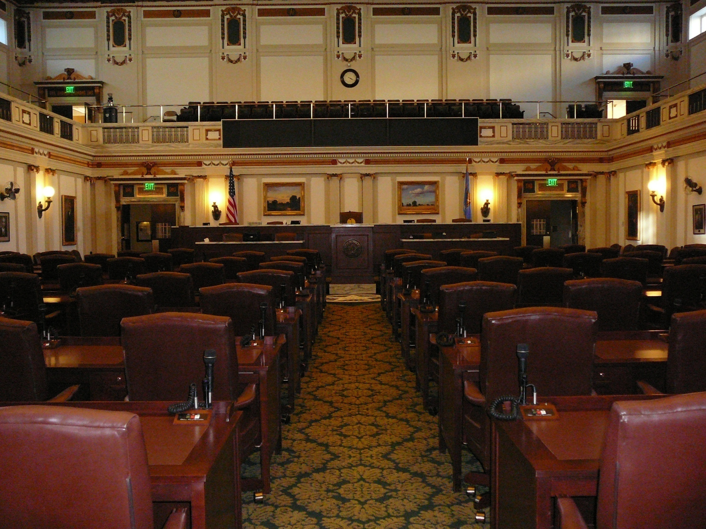
Notes:
House Chamber. Arrow is pointing to the “Score Board” – an electronic board which lists the legislator’s name, bill number, and vote Y or N.

Slide 19
Review…
Call & visit all of your elected officials
Lobby in person, by phone or email.
Write Letters To the Editor
Put Capitol contact information in your phone and share
Notes:
This presentation is broken up into 3 parts – The Basics; Lobbying; and Website and Legislation

Slide 20
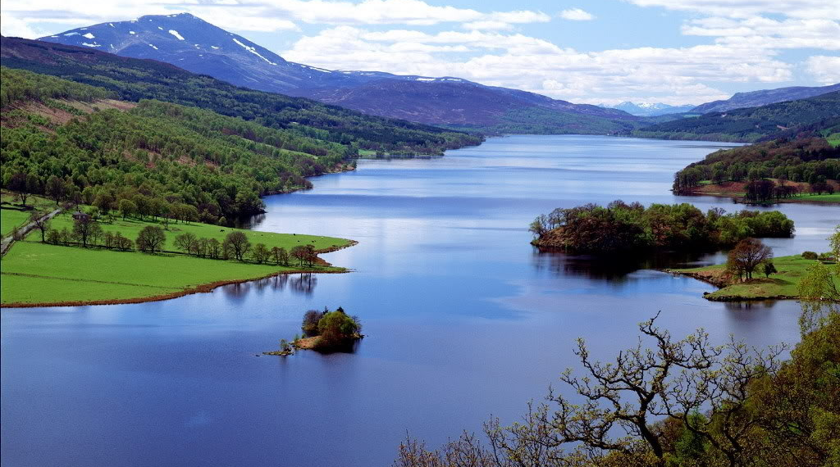
Review and Break
Questions?

Slide 21
Part Three
Leadership

Slide 22
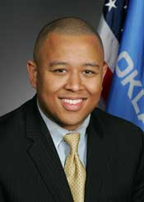
Leadership
House - Speaker
Majority Floor Leader
Deputy Floor Leader
Majority Whip
Caucus Chairman
Caucus Vice-Chariman
6 Ass’t Floor Leaders
Caucus Secretary
Governor
1 Chaplains/
1 Pages
8 Ass’t Majority Whips
A party member chosen to manage party activities in a legislative body:
Such a party member presiding over the whole legislative body when the party constitutes a majority
Minority Party Leadership - Similar structure with Leaders, Whips, and Caucus Chair
Notes:
House Leadership:
http://www.okhouse.gov/Members/Leadership.aspx
As of January 2011 – Slight change in leadership appointments:
This year ½ of the assistant floor leaders were elected by the caucus
This year ½ of the assistant Majority Whips were elected by the caucus
All the committee Chairman positions were appointed by the Speaker
These changes were basically meaningless since no one runs for those assistant positions anyway

Slide 23
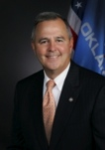
Leadership
Senate
Pro-Temp
Majority Floor Leader
3 Ass’t Floor Leaders
4 Majority Whips
2 Caucus Chairmen
1 Rural Chairman
Governor
A party member chosen to manage party activities in a legislative body:
Such a party member presiding over the whole legislative body when the party constitutes a majority
Minority Party Leadership - Similar structure of Leaders, Whips, and Caucus Chair
Notes:
House Leadership:
http://www.okhouse.gov/Members/Leadership.aspx

Slide 24
Committees
The power of appointment
Speaker and the
Pro Tempore
Leadership*
Maintains Party Position
Control of the Outcome
Committee Chairs
Control Bills Advancing to Floor
Elected by the Members:
Appointed:
*Some Exceptions
Result:
Notes:
*As of January 2011 – Slight change in leadership appointments:
This year ½ of the assistant floor leaders were elected by the caucus
This year ½ of the assistant Majority Whips were elected by the caucus
All the committee Chairman positions were appointed by the Speaker
These changes were basically meaningless since no one runs for those assistant positions anyway

Slide 25
Committees
Senate
House
16 Standing Committees
6 Appropriations Subcommittees
Follow Link:
http://www.oksenate.gov/Committees/standingcommittees.aspx
21 Standing Committees
12 Subcommittees
Conference Committees
Follow Link:
http://www.okhouse.gov/Committees/Default.aspx
Notes:
House: http://www.okhouse.gov/Committees/Default.aspx

Slide 26
Review…
Leadership is guided by the Governor’s Office
Has power of appointment
Controls the legislative process
Applies pressure
Notes:
This presentation is broken up into 3 parts – The Basics; Lobbying; and Website and Legislation

Slide 27
Part four
legislation

Slide 28
PURPOSE OF LAW
What is the Purpose of Law?
“The purpose of law is the defense of life, liberty, and property.”
(Source: Frederick Bastiat, The Law)
More recently:
“The obligations and purposes of law and government are to protect public health, safety, and morals, and to advance the general welfare—including, preeminently, protecting people's fundamental rights and basic liberties.”
(Source: First Things website, Robert P. George)
Notes:
Just thought I’d get this out of the way.

Slide 29
www.oklegislature.gov
Make this your home page
Review:
Legislation
Committees
Votes
Video Options
Notes:
Discuss the various options -
How to find House and Senate Home Page
Find My Legislator including phone and email
List of Legislators
Find Legislation
Watch Video from anywhere
Track Bills
Find Committees

Slide 30
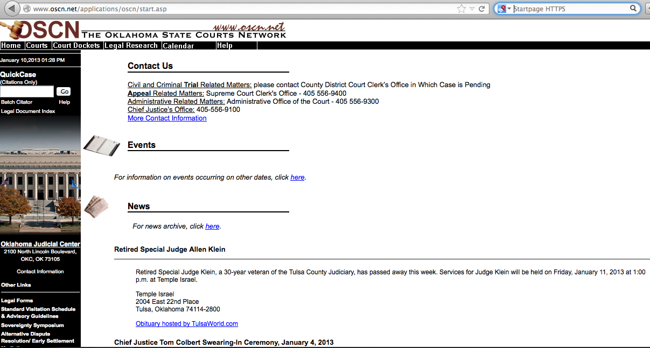
www.oscn.net
Make this Your other home page
Click Legal Research and Review Options:
OK Statutes, Constitution, etc.

Slide 31
OK TITLES OF LAW
WWW.OSCN.NET
From www.oscn.net
  Click Legal Research
  Click Oklahoma Statutes Citationized
85 Titles of Laws
Listed in numerical/alphabetical order
Titles w/ Frequent Flyer Miles: Children, Education, Motor Vehicles, Public Health and Safety, Revenue and Taxation
Seldom Done: The Act of Repeal, legislation that restores liberties
50,000 - Estimated number of laws

Slide 32
OK TITLES OF LAW www.oscn.net
Other Info on oscn.net:
Oklahoma Cases
Statutes
Session Laws
Administrative Code (links to Secretary of State website)
Constitution - OK and U.S.
Attorney General’s Opinions
Jury Instructions
Court Rules
Fee and Bond Schedules
More…

Slide 33

Legislation
Legislation does one of three things:
Amends existing law
Create new law
Repeals existing law
2011-12 OK Legislature Passed 755 Bills
Notes:
2011 - 385 bills
2012 - 370 bills
Total for 2-year session: 755 bills

Slide 34
Legislation
House Bills (HB) - Originate in the House
House Concurrent Resolutions
House Joint Resolutions
House Resolutions
Senate Bills (SB) - Originate in the Senate
Senate Concurrent Resolutions
Senate Joint Resolutions
Senate Resolutions
2011-12 OK Legislature Passed 755 Bills
Notes:
2011 - 385 bills
2012 - 370 bills
Total for 2-year session: 755 bills

Slide 35
HB 2130
EXAMPLE of
Amendatory language
ENGROSSED HOUSE
BILL NO. 2130 By: Steele and McCullough of the House
and Jolley of Senate
An Act relating to insurance; amending Section 2, Chapter 128, O.S.L. 2009 (36 O.S. Supp. 2010, Section 4602), which relates to the duties of the Health Care for the Uninsured Board; providing that the Executive Director shall advise and aid Board; specifying the Secretary of Health and Human Services shall be the Executive Director; providing for appointment of Board; specifying backgrounds of appointees; providing for the appointment of the original Board; specifying term of Board membership; providing for appointment of vacant positions; requiring initial meeting of Board; directing State Department of Health to provide space for meetings; changing agencies that direct implementation and duties of the Board; directing Board to apply for certain grants and funds; modifying Insurance Commissioner duties; and providing an effective date.
BE IT ENACTED BY THE PEOPLE OF THE STATE OF OKLAHOMA:
SECTION 1. AMENDATORY Section <2>, Chapter <128>, O.S.L. 20<09> (<36> O.S. Supp. 2010, Section <4602>), is amended to read as follows:
Section <4602>. A. The Insurance Commissioner in collaboration with the Oklahoma Health Care Authority Health Care for the Uninsured Board (HUB) Executive Director shall advise and aid the Health Care for the Uninsured Board (HUB) in its duties. The Secretary of Health and Human Services shall be the Executive Director. The Insurance Commissioner Executive Director is hereby authorized to promulgate such reasonable rules as are necessary to implement the purposes of this act.
1. The Health Care for the Uninsured Board shall consist of:
The HUB Bill- the first “exchange bill”
Notes:
Language can change by:
Amendment - change, add or strike language
Author
Committee
Floor
Committee Substitute - new language, same bill #
Conference Committee - Members assigned. More ad hoc. Caution: Language that has been removed from a controversial bill can end up being added to a bill that has gone to conference.

Slide 36
HB 3055
Example of new law
This act shall be known and may be cited as the "Water for 2060 Act".
SECTION 2. NEW LAW A new section of law to be codified in the Oklahoma Statutes as Section 1088.12 of Title 82, unless there is created a duplication in numbering, reads as follows:
The Legislature hereby declares that, in order to protect Oklahoma citizens from increased water supply shortages and groundwater depletions by the year 2060 in most of the eighty-two watershed planning basins in the state as described in the 2012 Update of the Oklahoma Comprehensive Water Plan, the public policy of this state is to establish and work toward a goal of consuming no more fresh water in the year 2060 than is consumed statewide in the year 2012, while continuing to grow the population and economy of the state and to achieve this goal through utilizing existing water supplies more efficiently and expanding the use of alternatives such as wastewater, brackish water, and other nonpotable supplies. Provided, however, that nothing in the Water for 2060 Act shall be construed as amending the provisions of law pertaining to rights or permits to use water.
SECTION 3. AMENDATORY 82 O.S. 2011, Section 1088.1, is amended to read as follows:
Section 1088.1. A. This section shall be known and may be cited as There is hereby created the "Oklahoma Water Conservation Grant Program Act".
B. The Oklahoma Water Resources Board shall solicit proposals for and make grants for the establishment of pilot programs which will implement water conservation projects or plans in communities in the state.
Water for 2060 Act -
“consume no more freshwater by 2060 than consumed in 2012…”

Slide 37
HB 1005 Example of a repeal bill
STATE OF OKLAHOMA
1st Session of the 54th Legislature (2013)
HOUSE BILL 1005 By: Glenn
AS INTRODUCED
An Act relating to contracts; repealing 15 O.S. 2011, Sections 598.1, 598.2, 598.3, 598.4, 598.5, 598.6, 598.7, 598.8, 598.9, 598.10 and 598.11, which relate to the Unfair Sales Act; and providing an effective date.
BE IT ENACTED BY THE PEOPLE OF THE STATE OF OKLAHOMA:
SECTION 1. REPEALER 15 O.S. 2011, Sections 598.1, 598.2, 598.3, 598.4, 598.5, 598.6, 598.7, 598.8, 598.9, 598.10 and 598.11, are hereby repealed.
SECTION 2. This act shall become effective November 1, 2013.
t
Usually Short
Repeals a section of the Oklahoma statutes, cited

Slide 38
This is when you make calls!
Checks and Balances:
Bills must pass through both chambers.
Both chambers must agree (vote) on all wording in each bill before it can be sent to the Governor for signing.

Slide 39
Bill Introduced
“Read”
Committee
Committee
Committee
This is when to make calls!
Do Pass
Do Pass w/amendment
Do Pass w/committee substitute
Do Not Pass
Bill is Sent to
Floor for Vote
Votes:
Stop

Slide 40
Review…
Principle: The purpose of law is the defense of life, liberty and property
Bills amend, create, or repeal law
All bills are assigned to a committee; follow legislative process
Committee chair controls legislation
Make oscn.net your home page

Slide 41
Review…
It is easier to advocate for or against a bill before it gets to the Floor for a vote
Make “group lists” of Committee Members’ emails
Call/email those Committee Members when the bill is in Committee

Slide 42

Review and Break
Questions?

Slide 43
Part five
How to read a bill with understanding

Slide 44
Newspeak
“The keyword here is blackwhite. Like so many Newspeak words, this word has two mutually contradictory meanings. Applied to an opponent, it means the habit of impudently claiming that black is white, in contradiction of the plain facts. Applied to a Party member, it means a loyal willingness to say that black is white when Party discipline demands this….”
Doublethink
— Part II, Chapter IX — The Theory and Practice of Oligarchical Collectivism
From Nineteen Eighty-Four, by Geo. Orwell
Notes:
http://en.wikipedia.org/wiki/Nineteen_Eighty-Four#Doublethink
But it means also the ability to believe that black is white, and more, to know that black is white, and to forget that one has ever believed the contrary. This demands a continuous alteration of the past, made possible by the system of thought which really embraces all the rest, and which is known in Newspeak as doublethink. Doublethink is basically the power of holding two contradictory beliefs in one's mind simultaneously, and accepting both of them.”

Slide 45
HB 2130
EXAMPLE of
Amendatory
ENGROSSED HOUSE
BILL NO. 2130 By: Steele and McCullough of the House
and Jolley of Senate
An Act relating to insurance; amending Section 2, Chapter 128, O.S.L. 2009 (36 O.S. Supp. 2010, Section 4602), which relates to the duties of the Health Care for the Uninsured Board; providing that the Executive Director shall advise and aid Board; specifying the Secretary of Health and Human Services shall be the Executive Director; providing for appointment of Board; specifying backgrounds of appointees; providing for the appointment of the original Board; specifying term of Board membership; providing for appointment of vacant positions; requiring initial meeting of Board; directing State Department of Health to provide space for meetings; changing agencies that direct implementation and duties of the Board; directing Board to apply for certain grants and funds; modifying Insurance Commissioner duties; and providing an effective date.
BE IT ENACTED BY THE PEOPLE OF THE STATE OF OKLAHOMA:
SECTION 1. AMENDATORY Section <2>, Chapter <128>, O.S.L. 20<09> (<36> O.S. Supp. 2010, Section <4602>), is amended to read as follows:
Section <4602>. A. The Insurance Commissioner in collaboration with the Oklahoma Health Care Authority Health Care for the Uninsured Board (HUB) Executive Director shall advise and aid the Health Care for the Uninsured Board (HUB) in its duties. The Secretary of Health and Human Services shall be the Executive Director. The Insurance Commissioner Executive Director is hereby authorized to promulgate such reasonable rules as are necessary to implement the purposes of this act.
1. The Health Care for the Uninsured Board shall consist of:
The HUB Bill- the first “exchange bill”
Copy of bill in your manual
Notes:
Language can change by:
Amendment - change, add or strike language
Author
Committee
Floor
Committee Substitute - new language, same bill #
Conference Committee - Members assigned. More ad hoc. Caution: Language that has been removed from a controversial bill can end up being added to a bill that has gone to conference.

Slide 46
HB 3055
Example of new law
This act shall be known and may be cited as the "Water for 2060 Act".
SECTION 2. NEW LAW A new section of law to be codified in the Oklahoma Statutes as Section 1088.12 of Title 82, unless there is created a duplication in numbering, reads as follows:
The Legislature hereby declares that, in order to protect Oklahoma citizens from increased water supply shortages and groundwater depletions by the year 2060 in most of the eighty-two watershed planning basins in the state as described in the 2012 Update of the Oklahoma Comprehensive Water Plan, the public policy of this state is to establish and work toward a goal of consuming no more fresh water in the year 2060 than is consumed statewide in the year 2012, while continuing to grow the population and economy of the state and to achieve this goal through utilizing existing water supplies more efficiently and expanding the use of alternatives such as wastewater, brackish water, and other nonpotable supplies. Provided, however, that nothing in the Water for 2060 Act shall be construed as amending the provisions of law pertaining to rights or permits to use water.
SECTION 3. AMENDATORY 82 O.S. 2011, Section 1088.1, is amended to read as follows:
Section 1088.1. A. This section shall be known and may be cited as There is hereby created the "Oklahoma Water Conservation Grant Program Act".
B. The Oklahoma Water Resources Board shall solicit proposals for and make grants for the establishment of pilot programs which will implement water conservation projects or plans in communities in the state.
Water for 2060 Act -
“consume no more freshwater by 2060 than consumed in 2012…”

Slide 47
HB 1005 Example of a repeal bill
STATE OF OKLAHOMA
1st Session of the 54th Legislature (2013)
HOUSE BILL 1005 By: Glenn
AS INTRODUCED
An Act relating to contracts; repealing 15 O.S. 2011, Sections 598.1, 598.2, 598.3, 598.4, 598.5, 598.6, 598.7, 598.8, 598.9, 598.10 and 598.11, which relate to the Unfair Sales Act; and providing an effective date.
BE IT ENACTED BY THE PEOPLE OF THE STATE OF OKLAHOMA:
SECTION 1. REPEALER 15 O.S. 2011, Sections 598.1, 598.2, 598.3, 598.4, 598.5, 598.6, 598.7, 598.8, 598.9, 598.10 and 598.11, are hereby repealed.
SECTION 2. This act shall become effective November 1, 2013.
t
Usually Short
Repeals a section of the Oklahoma statutes, cited

Slide 48
SB 463
Example of
Amendatory
as named or otherwise identified in the written request, to be used in the official capacity of the agency, the Commissioner may release such personal information to the agency pursuant to the provisions of the Driver’s Privacy Protection Act, 18 United States Code, Sections 2721 through 2725.
3. The Commissioner of Public Safety is authorized to establish procedures and enter into agreements with any other law enforcement agency of this state or political subdivision of this state for the purpose of providing direct electronic access to the photograph or image in computerized format of any person who has been issued a driver license or identification card by the Department of Public Safety. The procedures and agreements shall ensure that:
a. access to a photograph or image is for law enforcement purposes only and that each photograph or image accessed is provided only to law enforcement officers employed by the agency accessing the photograph or image,
b. any person charged with access to or custody and dissemination of a photograph or image or in receipt of a photograph or image shall not divulge or disclose the photograph or image except for law enforcement purposes, and in all cases shall not give, transfer, or otherwise provide the photograph or image:
Access to drivers license photo
“direct electronic access”
“for law enforcement purposes”

Slide 49
Doublespeak
Word | Assumed Meaning | Real/Political
Advanced | Forward; progressive; implies ‘better’ | Refers to technology developed by/for the Dept. of Defense morphed into commercial use
Career | Means of earning a living; a profession, chosen by the individual | Entry level job in a government-approved service industry; planned via Soviet-styled S-T-W education system
Knowledge-based Economy | Economy employing knowledgeable, well-educated people and practices | Economy based on the acquisition and analysis of information, utilizing technology; data driven
Quality Jobs | Excellent, high wage, long-term jobs | Industry-specific, temporary, low-wage, entry-level jobs in Enterprise/HUBZones, dependent on tax incentives

Slide 50
Doublespeak
Word | Assumed Meaning | Real/Political
Small Business | A locally-owned small business started by an individual with his own money | SBA approved business– i.e. “minority” or “veteran-owned,” located in an Enterprise/HUBZone – given preferential treatment, undermining free enterprise
Reduce the cost-drivers of doing business | Applies to all businesses; minimizes restrictive permitting, fees, zoning, regulations, etc. | Applies to select businesses only; includes tax credits/incentives, TIF districts, and elimination of competition
Create more jobs | Government gets out of the way-free enterprise system allowed to work | Directing funds (earmarks) to specific businesses; “Quality jobs” legislation that favors them; tax incentives
Smaller, Smarter Government | Defunding/Cessation of un-enumerated activities and agencies | Public-Private Partnerships; increased technology; outsourcing some functions

Slide 51
Government is NOT a Business!
Word | Assumed Meaning | Real/Political
Government needs to be run more like a business | Government operating in an orderly manner, not wasting taxpayers’ money, while still operating within its’ proper authority and respecting the God-given rights of the individual; operates as a sovereign entity with a constitution, with separate but equal Executive, Legislative, and Judicial branches. Does not function as a business. | Government operates from a business plan, focusing on revenue generation, cost savings, and efficiencies. Functions of government are viewed as services; services to the public are considered a business process & commoditized. May lead to outsourcing government services (“business processes”) to “eliminate waste, create efficiencies, and reduce fragmentation” Citizens viewed as an asset or liability; charged for using services.

Slide 52

Review and Break
Questions?

Slide 53
Part six
The agenda/the influencers

Slide 54
reinventing government
Administrative Technocracy vs. Representation
Government Modernization - Technology based, consolidation efforts, Chief Information Officer (CIO)
Capgemini - $1M contract for statewide assessment
Digital Government
E-Governance and ID cards - Real ID Concerns
E-Governance and the internet
E-Governance and service fees
Outsourcing of government functions
Office of State Finance now Office of Management and Enterprise Services (OMES) www.ok.gov/OSF/
Notes:
Link to Digital Government Strategy:
http://www.whitehouse.gov/blog/2012/08/23/building-blocks-21st-century-digital-government
KOKH Fox 25 OKC News
http://www.okcfox.com/newsroom/top_stories/videos/kokh_real-id-stirs-concern-travelers-7262.shtml
Capgemini website
http://www.us.capgemini.com/

Slide 55
Influencers
Federal Laws and Federal Dollars
National Council of State Legislators
ALEC - American Legislative Exchange Council - Model Legislation
National Governors Association
State Chamber of Commerce
Local Chambers of Commerce - Tulsa Metropolitan Chamber of Commerce
Oklahoma Municipal League
Regents for Higher Education
The Business Roundtable
Energy Council
Corporate Lobbyists
Principle vs. Politics

Slide 56
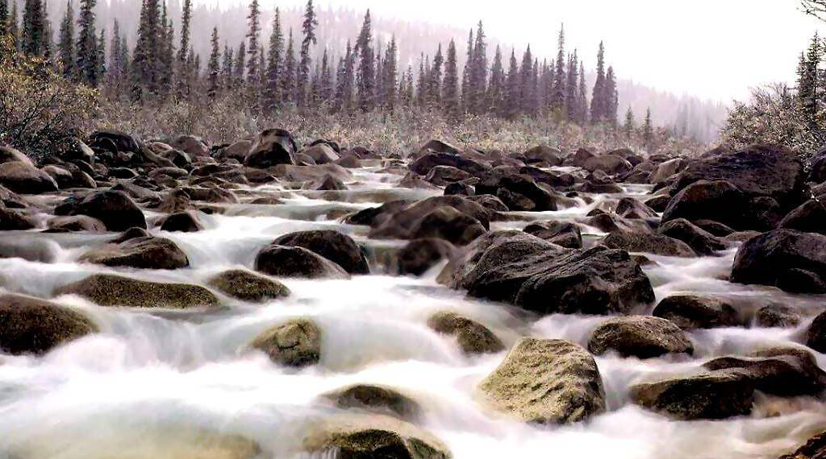
Review and Break
Questions?

Slide 57
Review…
It is easier to advocate for or against a bill before it gets to the Floor for a vote
Make “group lists” of Committee Members’ emails
Call/email those Committee Members when the bill is in Committee

Slide 58
Action Steps
Learn how the legislative process works – then work the process
Call, Meet, and Write to State Legislators (include voting address)
If no response in 5 days, email legislator, requesting reply
Make an appointment to meet him/her personally
Inform yourself and others – (Sunday school, work, etc. Recruit them.)
Keep in touch – read the information and alerts
Avoid groups that do not include a link to the bill they’re asking support for – something is wrong.
Join/donate to grassroots groups
Attend Action Meetings
Make the calls when asked!
Plan to visit the Capitol at least twice during the session; more if time permits
Get involved in your precincts, and in the county and state party

Slide 59
OK-SAFE, Inc.™
Visit our websites:
  www.ok-safe.com
  www.exposinghealthcarereform.com
AxXiom For Liberty: www.axxiomforliberty.com
Sign up for the Newsletter and Action Alerts
Read to understand the issues and language
Contact your elected officials – today
Make those calls when notified – they work!

